Slide 1
Add functionality

Slide 2
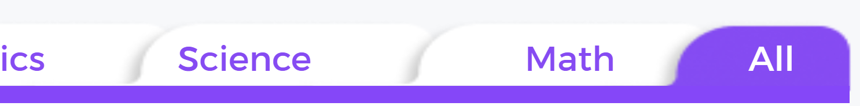
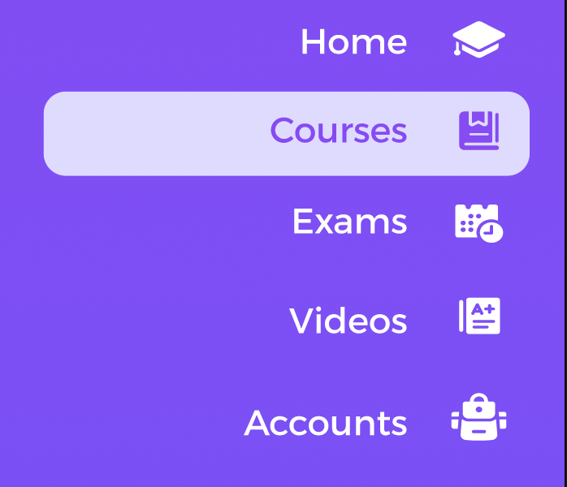
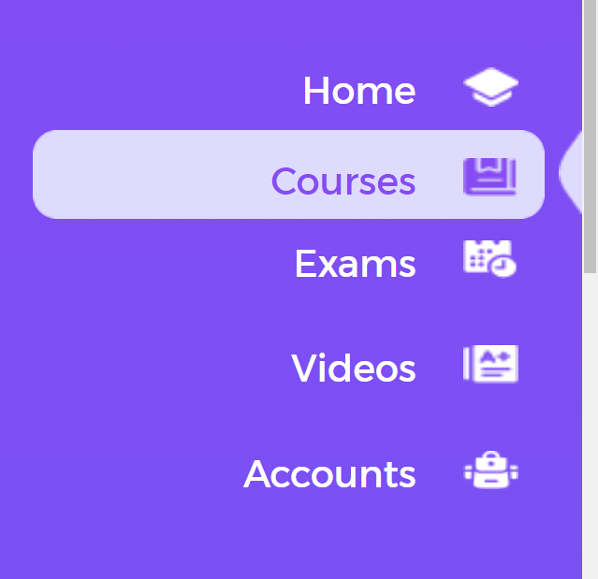
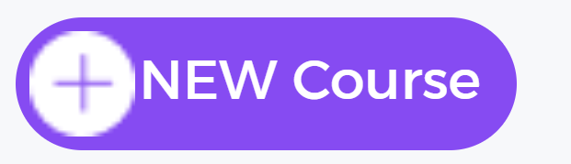
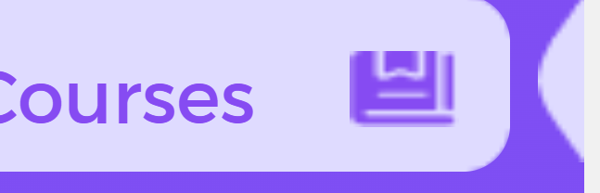
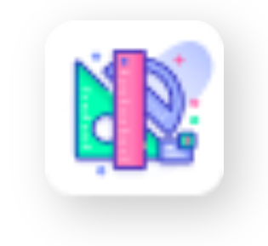

All icons are pixelated please fix that
Change all icons from PNG to SVG
Icons size and format should be the same
All edges are pixelated can we fix that ?

Slide 3
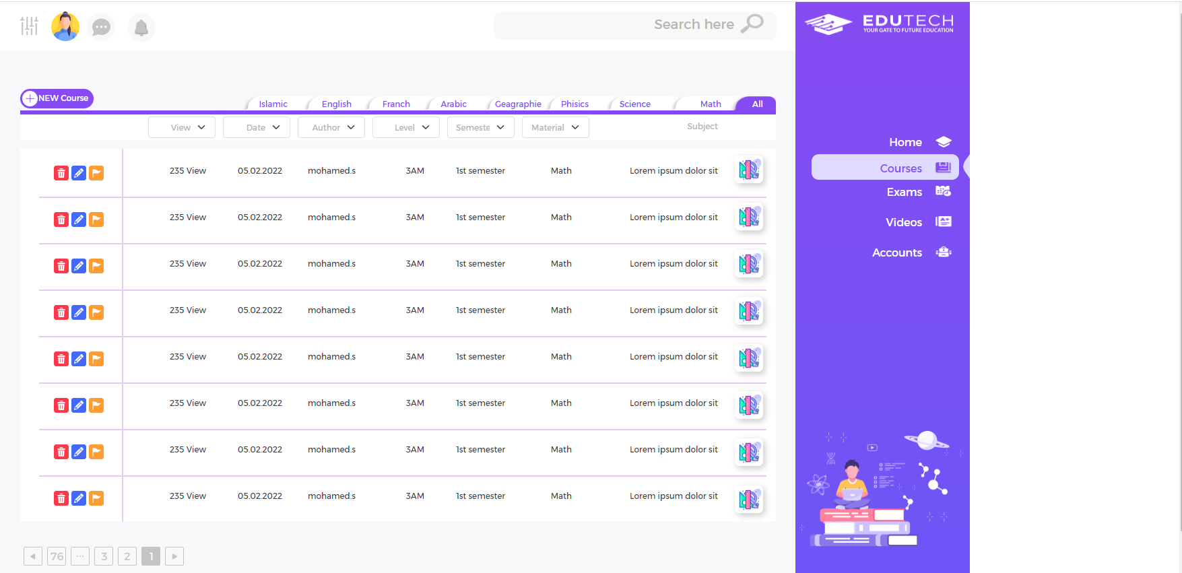
Find a solution for this gap ( responsive layout will fix that we can work on it later )

Slide 4
Make the text in model of the row

Slide 5
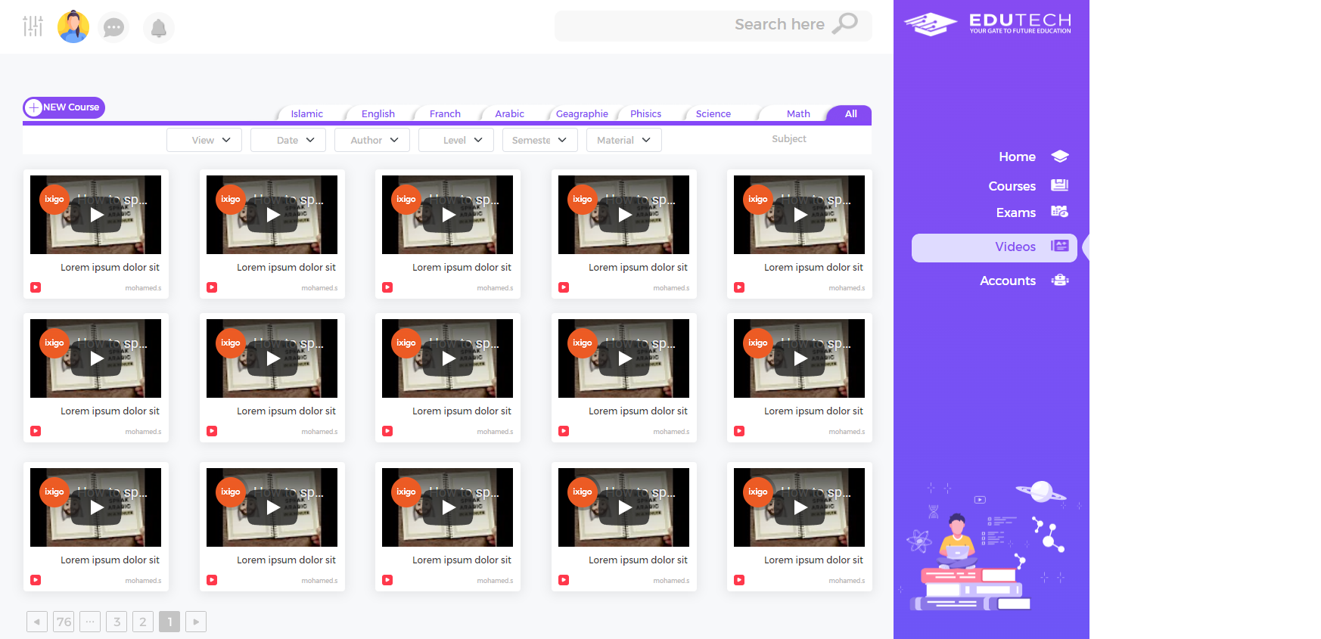
We just need the thumbnail image hear to displayed the same as YouTube

Slide 6
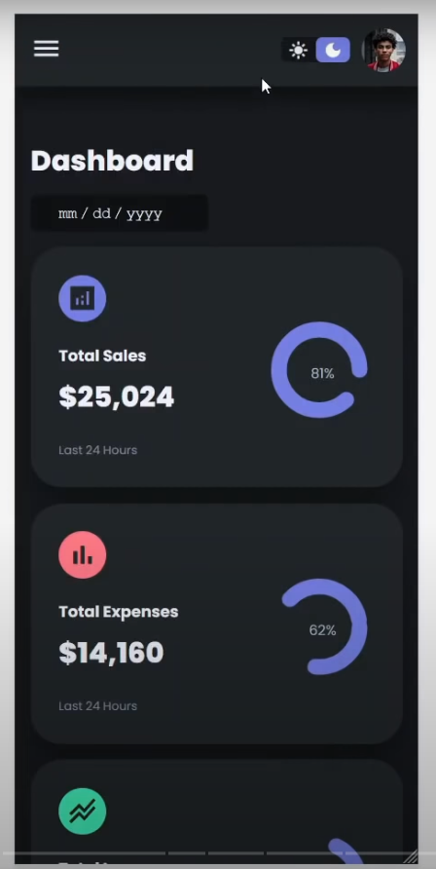
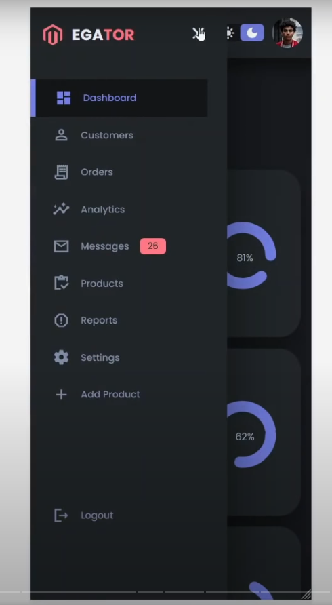
1
2
This how the right menu will look like on mobile

Slide 7

Side menu functionality
https://www.youtube.com/watch?v=wEfaoAa99XY

